Slide 1
Hashing Techniques

Slide 2

Introduction
Suppose we want to design a system for storing employee records keyed using phone numbers.
And we want following queries to be performed efficiently:
Insert a phone number and corresponding information.
Search a phone number and fetch the information.
Delete a phone number and related information.

Slide 3

Introduction
We can think of using the following data structures to maintain information about different phone numbers.
Array of phone numbers and records.
Linked List of phone numbers and records.
Balanced binary search tree with phone numbers as keys.
Direct Access Table.

Slide 4
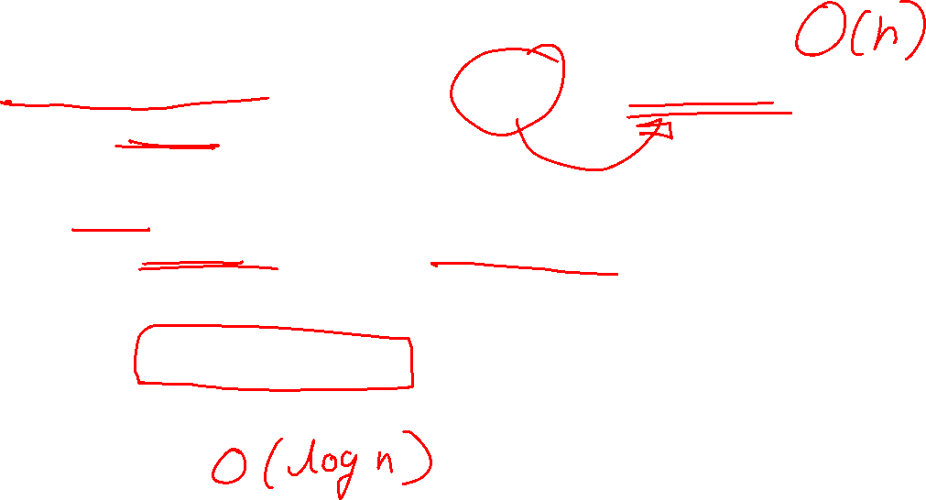
What is the need of Hashing Technique ?
For arrays and linked lists, we need to search in a linear fashion, which can be costly in practice.
If we use arrays and keep the data sorted, then a phone number can be searched in O(Log n) time using Binary Search, but insert and delete operations become costly as we have to maintain sorted order.
With balanced binary search tree, we get moderate search, insert and delete times. All of these operations can be guaranteed to be in O(Log n) time.

Slide 5
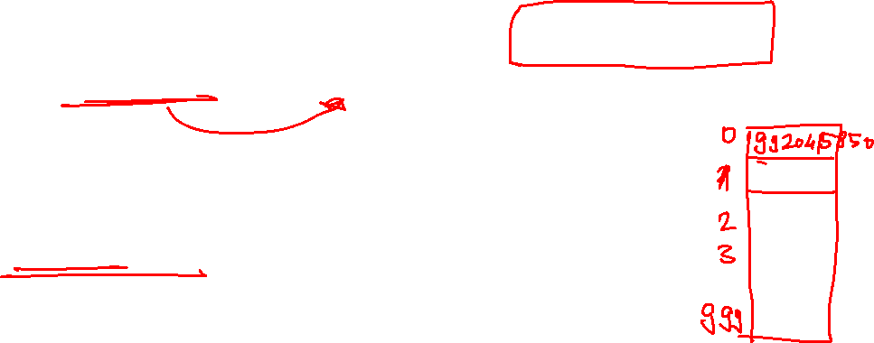
What is the need of Hashing Technique ?
Another solution that one can think of is to use a direct access table where we make a big array and use phone numbers as index in the array.
Time complexity wise this solution is the best among all, we can do all operations in O(1) time.

Slide 6

What is the need of Hashing Technique ?
For example to insert a phone number, we create a record with details of given phone number, use phone number as index and store the pointer to the created record in table.
This solution has many practical limitations.
First problem with this solution is extra space required is huge.
For example if phone number is n digits, we need O(m * 10n ) space for table where m is size of a pointer to record.
Another problem is an integer in a programming language may not store n digits.

Slide 7

What is Hashing?
Hashing is the solution that can be used in almost all such situations and performs extremely well compared to above data structures like Array, Linked List, Balanced BST in practice.
With hashing we get O(1) search time on average (under reasonable assumptions) and O(n) in worst case.
Hashing is an improvement over Direct Access Table.

Slide 8
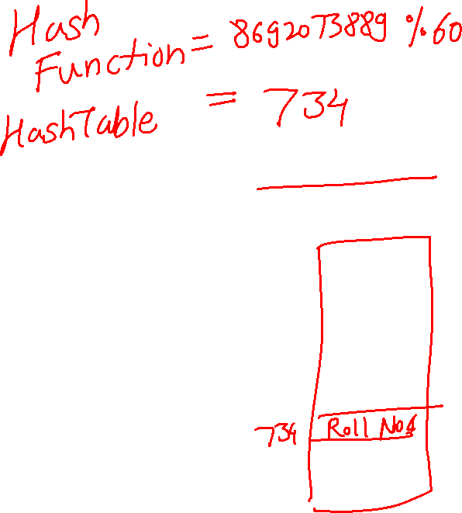
What is Hashing?
The idea is to use hash function that converts a given phone number or any other key to a smaller number and uses the small number as index in a table called hash table.

Slide 9
Hash Function
A function that converts a given big phone number to a small practical integer value.
The mapped integer value is used as an index in hash table.
In simple terms, a hash function maps a big number or string to a small integer that can be used as index in hash table.
A good hash function should have following properties
Efficiently computable.
Should uniformly distribute the keys (Each table position equally likely for each key)

Slide 10
Hash Table
An array that stores pointers to records corresponding to a given phone number.
An entry in hash table is NIL if no existing phone number has hash function value equal to the index for the entry

Slide 11
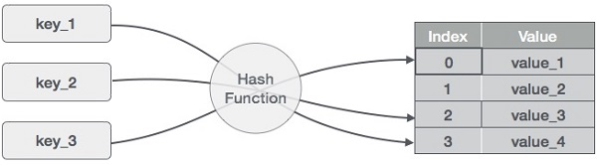
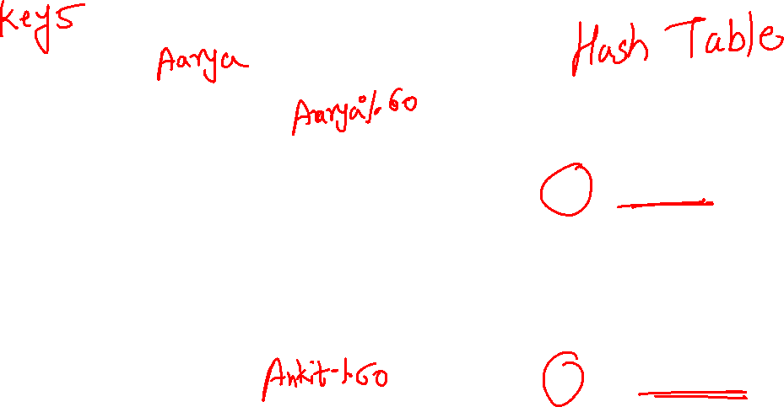

Slide 12
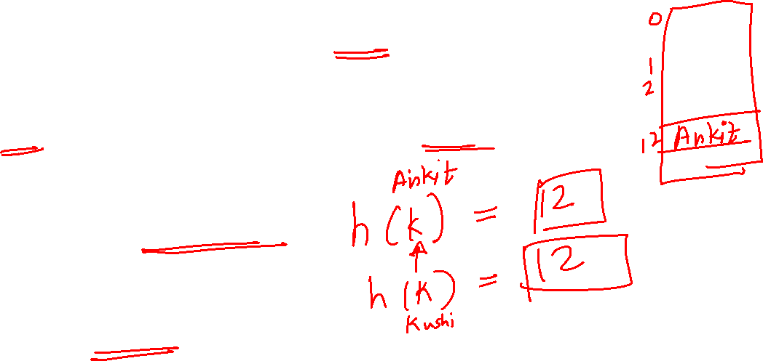
Point to remember
Hashing = use a table (array/vector) of size m to store to store elements from a set of much larger size elements
given a key, use a function h to compute the slot h(k) for that key.
Terminology: Terminology:
h is a hash function hash function
K hashes to slot h(k)
The hash value of k is h(k)
collision: when two keys have the same hash

Slide 13

Hash Function : Truncation
Truncation Ignore part of the key and use the remaining part part of the key and use the remaining part directly as the index. directly as the index.
Example: if the keys are 8 : if the keys are 8-digit numbers and the digit numbers and the hash table has 1000 entries, then the first, fourth and eighth digit could make the hash function and eighth digit could make the hash function.
Not a very good method : does not distribute keys

Slide 14
Types of Hash Function
Truncation
Mid-square Method
Folding Method
Division Method

Slide 15
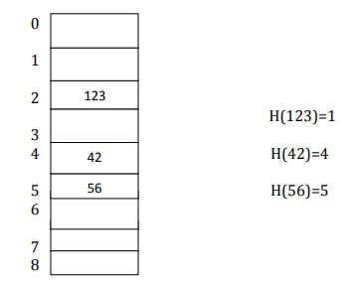
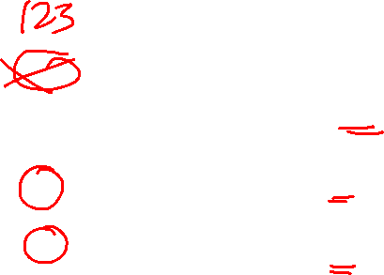
Hash Function : Truncation
The Truncation Method truncates a part of the given keys, depending upon the size of the hash table.
Choose the hashtable size.
2. Then the respective right most or left most digits are truncated and used as hash code| value.
Ex: 123,42,56 Table size = 9

Slide 16
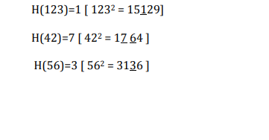
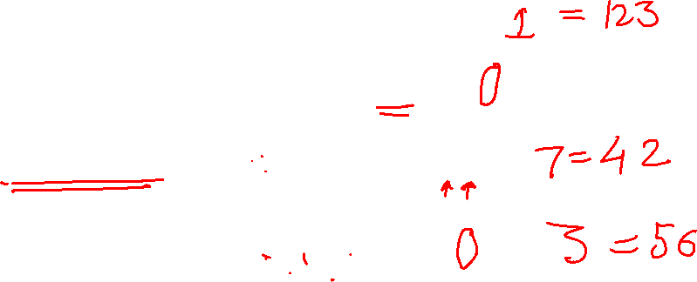
Hash Function : Mid-square
1. Square the given keys.
2. Take the respective middle digits from each squared value and use that as the hash value | address | index | code, for the respective keys.

Slide 17
Hash Function : Folding
Break up the key in parts and combine them in Break up the key in parts and combine them in some way. some way.
Example : if the keys are 8 digit numbers and the : if the keys are 8 digit numbers and the hash table has 1000 entries, break up a key into three, three and two digits, add them up and, if necessary, truncate them.
Better than truncation.

Slide 18
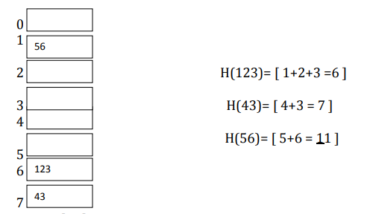
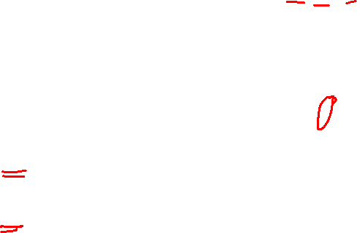
Hash Function : Folding
Partition the key K into number of parts, like K1,K2,.....Kn, then add the parts together and ignore the carry and use it as the hash value.

Slide 19
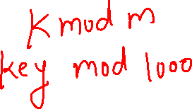
Hash Function : Division
If the hash table has m slots, define slots, define
h(k)=k mod m
Fast
Good values for m are prime numbers prime numbers that are not that are not close to powers of 2.

Slide 20
Sr.No. | Key | Hash | Array Index
1 | 1 | 1 % 20 = 1 | 1
2 | 2 | 2 % 20 = 2 | 2
3 | 42 | 42 % 20 = 2 | 2
4 | 4 | 4 % 20 = 4 | 4
5 | 12 | 12 % 20 = 12 | 12
6 | 14 | 14 % 20 = 14 | 14
7 | 17 | 17 % 20 = 17 | 17
8 | 13 | 13 % 20 = 13 | 13
9 | 37 | 37 % 20 = 17 | 17
(1,20)
(2,70)
(42,80)
(4,25)
(12,44)
(14,32)
(17,11)
(13,78)
(37,98)

Slide 21
What is Collision
Since a hash function gets us a small number for a big key, there is possibility that two keys result in same value.
The situation where a newly inserted key maps to an already occupied slot in hash table is called collision and must be handled using some collision handling technique.

Slide 22
Collision Resolution
Following are the ways to handle collisions:
• Chaining: The idea is to make each cell of hash table point to a linked list of records that have same hash function value. Chaining is simple, but requires additional memory outside the table.
• Open Addressing: In open addressing, all elements are stored in the hash table itself. Each table entry contains either a record or NIL.

Slide 23
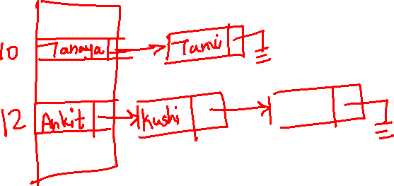
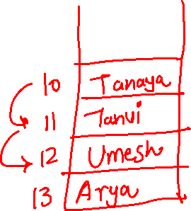
Collision Handling
Following are the ways to handle collisions:
It is the process of finding another position for the collided record. The techniques are:
Separate Chaining. Closed Addressing
2. Linear Probing.
3. Quadratic Probing. Open Addressing
4. Double Hashing.

Slide 24
Separate Chaining Bucket Hashing
The idea is to make each cell of hash table point to a linked list of records that have same hash function value.
Let us consider a simple hash function as “key mod 7” and sequence of keys as 50, 700, 76, 85, 92, 73, 101.

Slide 25
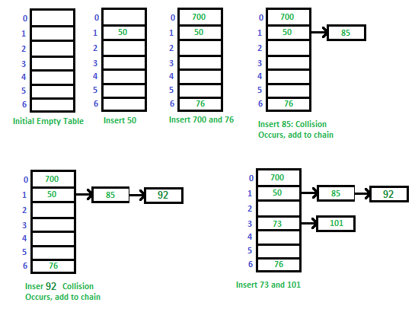
Separate Chaining

Slide 26
Advantages:
Simple to implement.
2) Hash table never fills up, we can always add more elements to the chain.
3) Less sensitive to the hash function or load factors.
4) It is mostly used when it is unknown how many and how frequently keys may be inserted or deleted.

Slide 27
Disadvantages:
Cache performance of chaining is not good as keys are stored using a linked list. Open addressing provides better cache performance as everything is stored in the same table.
2) Wastage of Space (Some Parts of hash table are never used)
3) If the chain becomes long, then search time can become O(n) in the worst case.
4) Uses extra space for links.

Slide 28
Performance of Chaining:
Performance of hashing can be evaluated under the assumption that each key is equally likely to be hashed to any slot of table (simple uniform hashing).
m = Number of slots in hash table
n = Number of keys to be inserted in hash table
Load factor α = n/m
Expected time to search = O(1 + α)
Expected time to delete = O(1 + α)
Time to insert = O(1)
Time complexity of search insert and delete is O(1)

Slide 29
Open Addressing
Like separate chaining, open addressing is a method for handling collisions.
In Open Addressing, all elements are stored in the hash table itself.
So at any point, the size of the table must be greater than or equal to the total number of keys (Note that we can increase table size by copying old data if needed).
Insert(k): Keep probing until an empty slot is found. Once an empty slot is found, insert k.
Search(k): Keep probing until slot’s key doesn’t become equal to k or an empty slot is reached.
Delete(k): If we simply delete a key, then the search may fail. So slots of deleted keys are marked specially as “deleted”. The insert can insert an item in a deleted slot, but the search doesn’t stop at a deleted slot.

Slide 30
Linear Probing
In linear probing, we linearly probe for next slot. For example, the typical gap between two probes is 1 as taken in below example also. let hash(x) be the slot index computed using a hash function and S be the table size
If slot hash(x) % S is full, then we try (hash(x) + 1) % S If (hash(x) + 1) % S is also full, then we try (hash(x) + 2) % S If (hash(x) + 2) % S is also full, then we try (hash(x) + 3) % S .................................................. ..................................................
Let us consider a simple hash function as “key mod 7” and sequence of keys as 50, 700, 76, 85, 92, 73, 101.

Slide 31
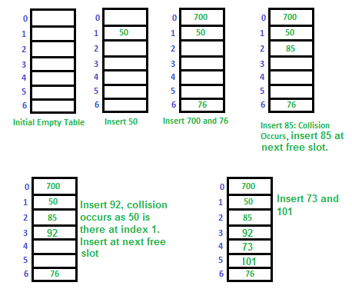

Slide 32
Quadratic Probing
We look for i²‘th slot in i’th iteration.
let hash(x) be the slot index computed using hash function.
If slot hash(x) % S is full, then we try (hash(x) + 1*1) % S
If (hash(x) + 1*1) % S is also full, then we try (hash(x) + 2*2) % S
If (hash(x) + 2*2) % S is also full, then we try (hash(x) + 3*3) % S

Slide 33
Double Hashing
We use another hash function hash2(x) and look for i*hash2(x) slot in i’th rotation.
let hash(x) be the slot index computed using hash function.
If slot hash(x) % S is full, then we try (hash(x) + 1*hash2(x)) % S
If (hash(x) + 1*hash2(x)) % S is also full, then we try (hash(x) + 2*hash2(x)) % S
If (hash(x) + 2*hash2(x)) % S is also full, then we try (hash(x) + 3*hash2(x)) % S

Slide 34
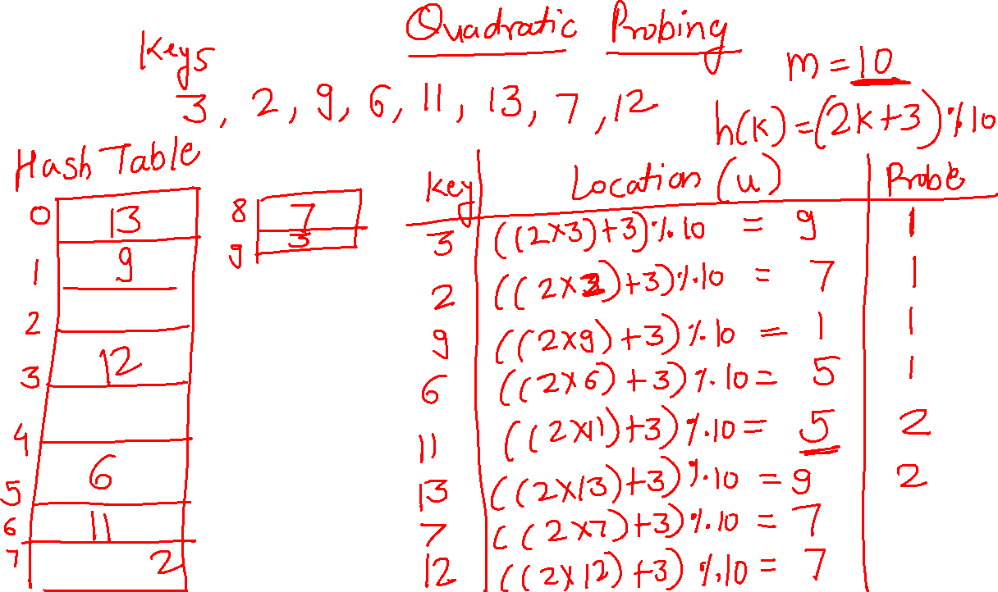

Slide 35
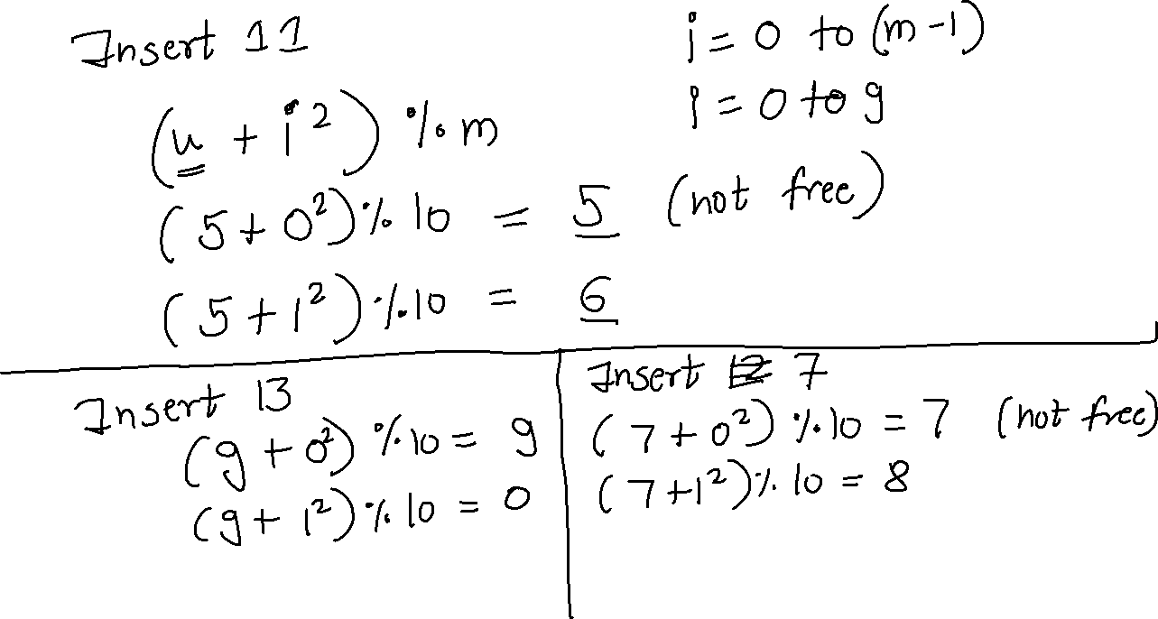

Slide 36
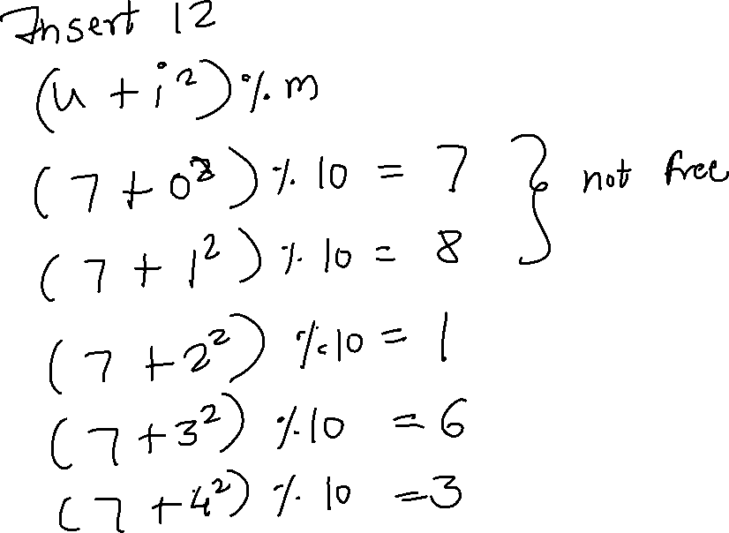

Slide 37
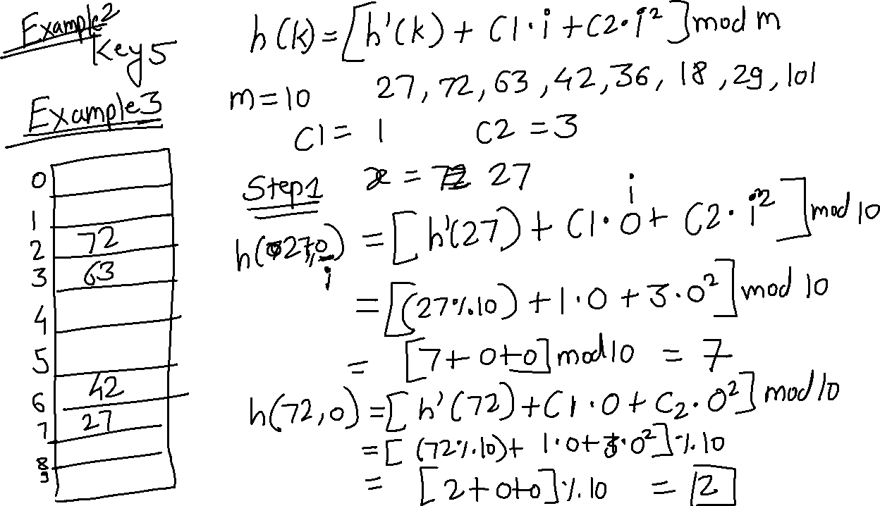

Slide 38
